Slide 1

ACCELERATED COMPUTING USING AI

Slide 2

PRJ_13

Slide 3
Project Members
JANSON ALBI SCARIA : NEC0821076
PINNIBOINA RAJESH : NEC0821049
PAUL PRAVIN KALE : NEC0821047
SHIVESH BABU : NEC0821022
THARUNRANGASWAMY. B : NEC0821092
PROJECT ID: PRJ_13
PROJECT GUIDE : Mr. Liju Gangadharan

Slide 4
Table of Contents
1. Introduction
2. Objective/Scope of our project
3. System Study/ Feasibility Study
3.1 Study on Existing System
3.2 Demerits of Existing System
3.3 Study of Proposed System
3.4 Merits of Proposed System
4. Software Requirement Specification(SRS)
5. Hardware Specification
6. Software Specification
7. Modules and Functionalities
8. Data Flow Diagram/Architecture Diagram
9. ER Diagram / Block Diagram
10. Architecture
11. PEAS diagram
12. Development Model/Approach
13. Gantt Chart
14. Testing and Implementation Procedures
15. Sample Screenshot
16. Scope Of Future Enhancements
17. Conclusion

Slide 5
Introduction

Slide 6

1. Introduction
ReaccelAI:
Comprehensive solution for model creation, training, and accelerating AI/ML models
User-friendly web interface for easy navigation and interaction
Focus on leveraging advanced hardware and software tools
Empowers AI/ML innovation and scalability
Automates and enhances model performance for developers
Enables seamless deployment for maximum performance
Notes:
Jansa

Slide 7
Objective/Scope of the Project

Slide 8
2. Objective/Scope of the Project
Empower organizations and developers with advanced hardware and software tools for enhanced performance, scalability, and efficiency.
Automate routine tasks like data preprocessing, model selection, and hyperparameter tuning, freeing users to focus on innovation and problem-solving. Providing ML training and deployment environment.
Ensure smooth transition of AI/ML models from development to live operations without compromising performance or reliability.
Provide valuable insights into model behavior, helping users identify areas for improvement and optimize efficiency.
Drive innovation and efficiency by continuously refining and enhancing AI/ML capabilities, ultimately shaping the future of artificial intelligence and machine learning.

Slide 9
System Study/ Feasibility Study

Slide 10
3. System Study/ Feasibility Study
Technical Feasibility
Automated processes to reduce errors
Scalable architecture for varying workloads
Operational Feasibility
User-friendly interface.
Efficient resource optimization.
Economic Feasibility
Long-term ROI
Cost savings through automation

Slide 11
Study on Existing System

Slide 12
3.1 Study on Existing System
Model Development Inefficiencies: Manual training slows development cycles.
Architectural Ambiguities: Lack of recommendation tools leads to suboptimal structures.
Performance Bottlenecks: No GPU acceleration hinders AI, ML, and software performance.
Complex Deployment: Manual processes limit scalability and agility.
User Experience Challenges: Non-user-friendly interface results in poor experience.
Operational Overhead: High hardware and software requirements increase costs.

Slide 13
Demerits of Existing System

Slide 14
3.2 Demerits of Existing System
Complexity: Existing AI/ML systems often lack user-friendly interfaces and require specialized expertise for operation.
Scalability Challenges: Many systems struggle to scale effectively with large datasets and complex models, requiring substantial computational resources.
Integration Difficulties: Integrating AI/ML systems with existing IT infrastructure and diverse data sources poses significant compatibility challenges.
Security Risks: Ensuring robust data security measures and compliance with privacy regulations remains a critical concern.
High Costs: Initial setup expenses, ongoing maintenance costs, and dependencies on specific technologies contribute to high overall costs.
Dependencies on Specific Technologies: Systems may be tied to particular hardware, software frameworks, or cloud platforms, limiting flexibility and adaptability.

Slide 15
Study on Proposed Systems

Slide 16
3.3 Study on Proposed Systems
The proposed ReaccelAI system offers numerous advantages, enhancing efficiency, reliability, and scalability in AI/ML model development.
By automating routine tasks and optimizing resource management, ReaccelAI significantly reduces the time and effort required for model training and deployment.
Its comprehensive analytics and performance monitoring tools provide continuous insights for model improvement, ensuring sustained high performance and innovation.

Slide 17
Merits of Proposed Systems

Slide 18
3.4 Merits of Proposed Systems
Automated Model Training: Streamlines training, reducing manual efforts and accelerating development.
GPU Acceleration: Utilizes CUDA Toolkit and cuDNN for faster and more efficient
AI/ML applications.
User-Friendly Web Interface: Offers an intuitive portal for easy user interaction.
Adaptive AI Recommendations: Learns from interactions, continually improving recommendations.
Enhanced Scalability: Cloud integration allows handling increased workloads effectively.

Slide 19
Software
Requirement Specification

Slide 20
4. Software Requirement Specification
Functional Requirements: Automate AI model training
Performance Requirements: Utilize GPU acceleration to enhance performance and reduce processing time for intensive tasks.
User Interface Requirements: Offer an intuitive web interface for efficient user interaction with various modules.
Security Requirements: Implement robust IAM controls to ensure secure access and compliance with authorization policies.

Slide 21
Hardware Specification

Slide 22
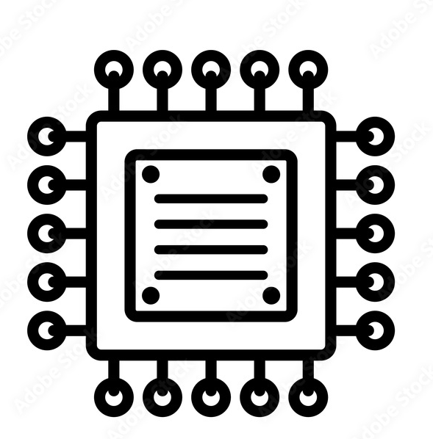
5. Hardware Specification
PROCESSOR : Intel core i7 or above
RAM : 16 GB Ram or above
HARD DISK : 512 GB storage or above
SERVICES : Google cloud, Boto3
GPU : NAS, NVIDIA GPU with CUDA support

Slide 23
Software Specification

Slide 24
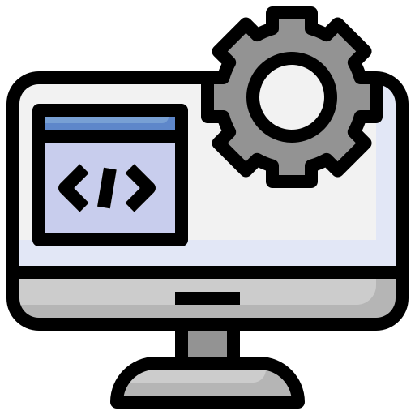
6. Software Specification
OS : Windows, macOS, and Linux distributions
IDE : VS Code/ Jupyter Notebook
WEB FRAMEWORK : Django
API : Fetch API, RESTful API
LANGUAGES : HTML, CSS, JavaScript, Python, Ajax
DEVOPS TOOLS : Git, Jenkins
DATABASE : MYSQL
LIBRARIES : TensorFlow, PyTorch, Optuna, YOLO, PytesHyperparameter Optimization (HPO), React KERAS & Auto KERAS

Slide 25
Modules and Functionalities

Slide 26
7. Modules and Functionalities
Model Creation: Automates the entire AI/ML training process, supporting frameworks like TensorFlow and PyTorch, and includes data preprocessing tools. Offers comprehensive model evaluation with metrics and visualizations to help understand performance indicators.
Inference Engine : The inference engine in ReaccelAI executes trained AI/ML models to generate predictions from new data. Utilizing optimized algorithms and GPU acceleration, it ensures fast, accurate results and seamless integration with other modules. This supports real-time data processing, enhancing the platform's scalability and reliability.
IAM (Identity and Access Management): Controls access with role-based access control and secure login mechanisms, ensuring only authorized users can access the platform. Manages user permissions to maintain high security and operational efficiency.

Slide 27
7. Modules and Functionalities
Testing : Provides detailed logs and error reports to help developers debug and optimize code effectively.
Analysis Module (Pre and Post):
Offers tools for data visualization and statistical analysis to improve model
performance and business outcomes.
Resource Utilization: Optimizes computing resource allocation based on task requirements and monitors usage in real-time. Provides analytics on resource consumption to help organizations plan and manage their infrastructure effectively.
Notes:
Shivesh

Slide 28
Data Flow Diagram/
Architecture Diagram

Slide 29
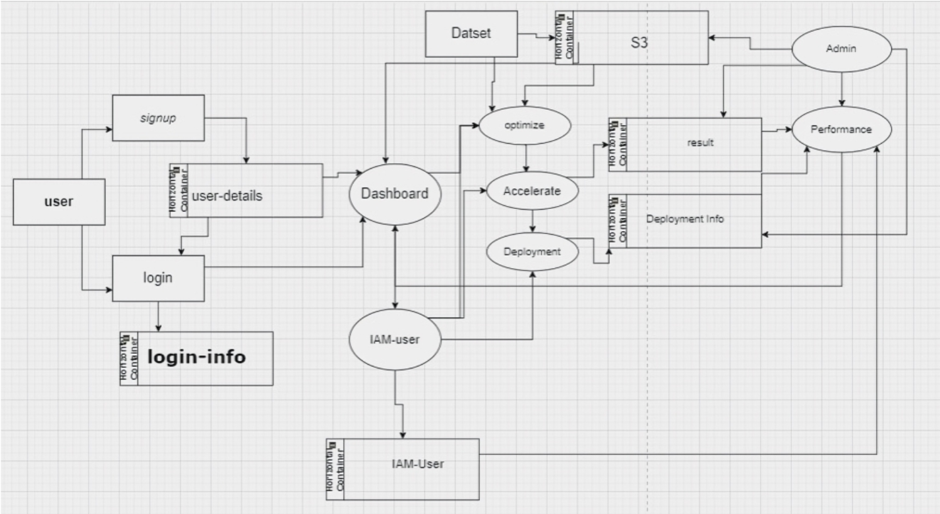
8. Data Flow Diagram

Slide 30
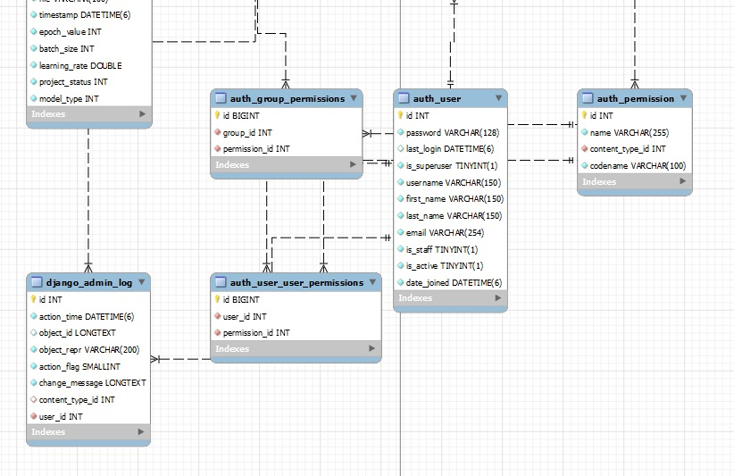
9. ER diagram

Slide 31
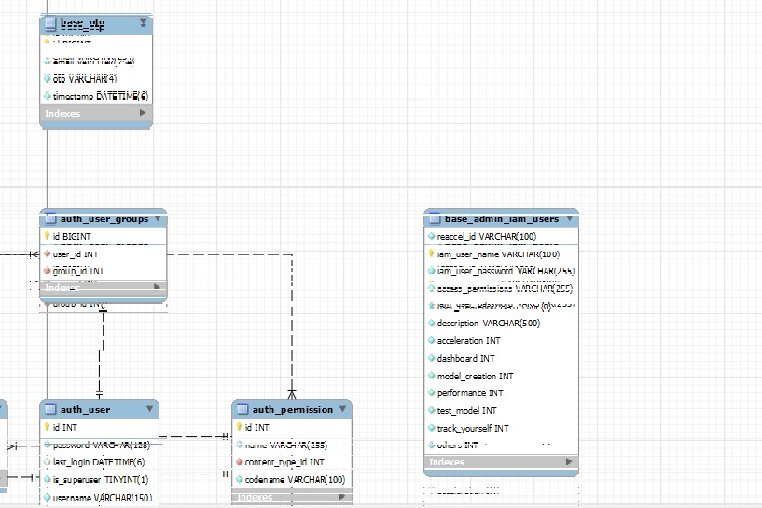
9. ER diagram

Slide 32
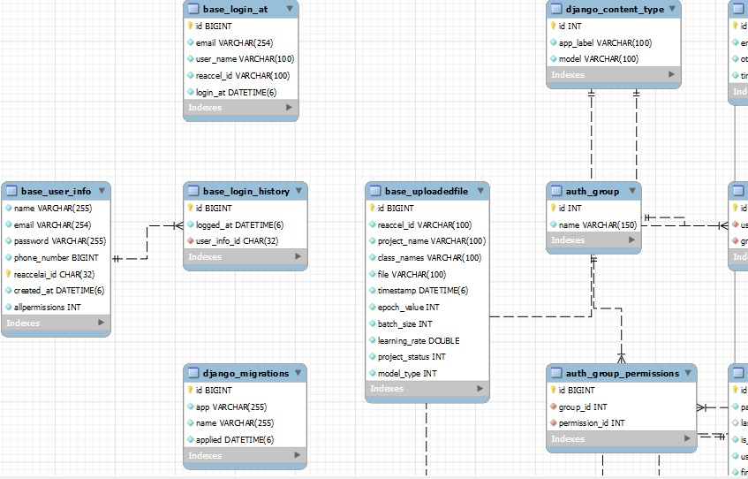
9. ER diagram

Slide 33
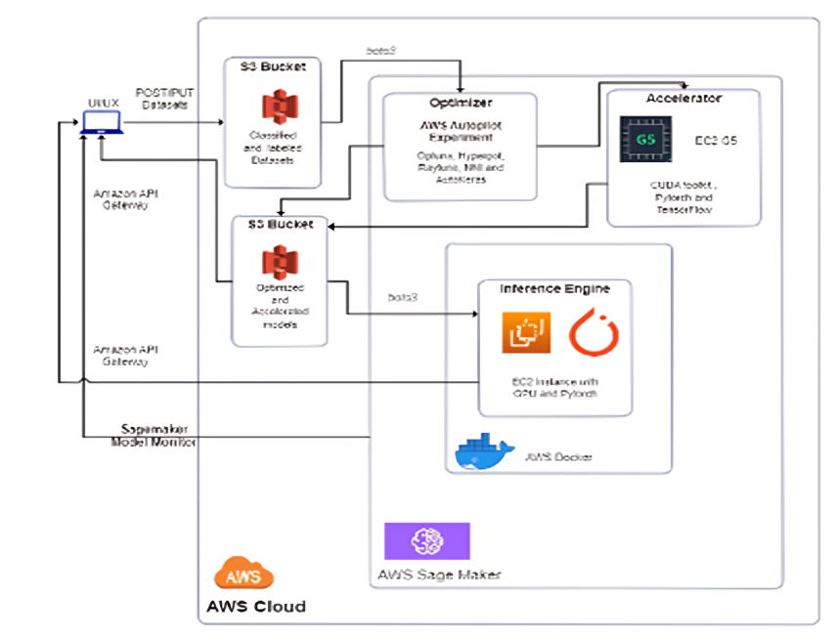
10. Architecture Diagram

Slide 34
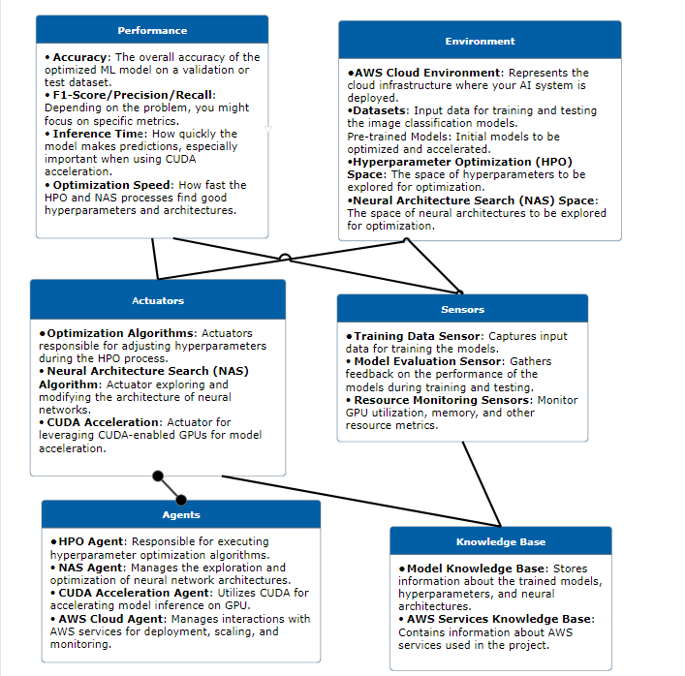
11. PEAS Diagram

Slide 35
12. Development Model/Approach
The development model for ReaccelAI follows an Agile methodology, ensuring flexibility, continuous improvement, and rapid delivery of features. This approach involves iterative cycles, with each iteration focusing on specific modules or functionalities
Iterative Cycles: Each iteration focuses on developing and refining specific modules or functionalities, ensuring continuous improvement and adaptability.
Rapid Delivery: Agile methodology enables quick delivery of features, allowing for timely updates and enhancements to the platform.
Flexibility: The approach supports dynamic changes in requirements and priorities, ensuring the project remains aligned with user needs and technological advancements.

Slide 36
Gantt chart

Slide 37
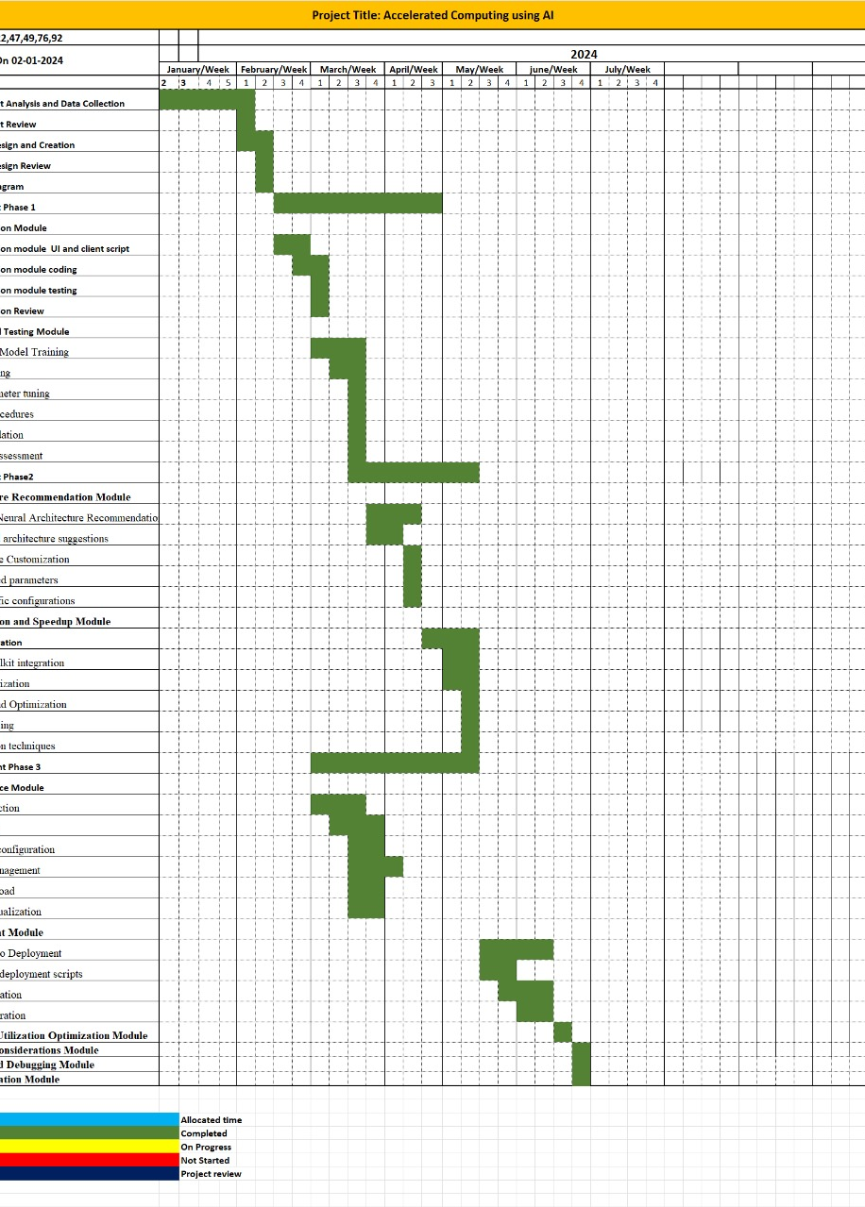
13. Gantt chart

Slide 38
Testing and Implementation Procedures

Slide 39
14. Testing and
Implementation Procedures
Testing involves techniques to determine the correctness of an application based on predefined scripts, aiming to identify and correct application failures.
It evaluates the software's behavior against criteria such as past versions, comparable products, expected interfaces, and relevant standards.
Testing examines and executes code in various environments, with a dedicated team separate from development to improve the software process.
Successful software depends on user acceptance, intuitive interfaces, robust functionality, and thorough testing, ensuring the product meets the needs of its target audience.

Slide 40

Implementation Procedures
Blackbox Testing: Tests functions based on specified requirements without considering the internal program structure, focusing on input and output data.
Unit Testing: Developers test individual modules to ensure they work correctly, verifying each part of the code.
Functionality Testing: Verifies that each function of the software application works as expected by providing appropriate input and checking against functional requirements.
Integration Testing: Tests the interactions between combined modules to ensure smooth data flow and functionality between different components.

Slide 41
Sample Screenshot

Slide 42

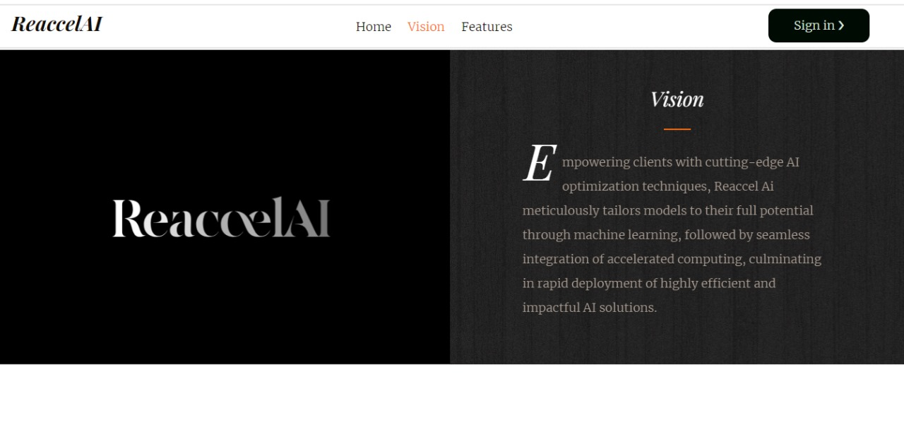
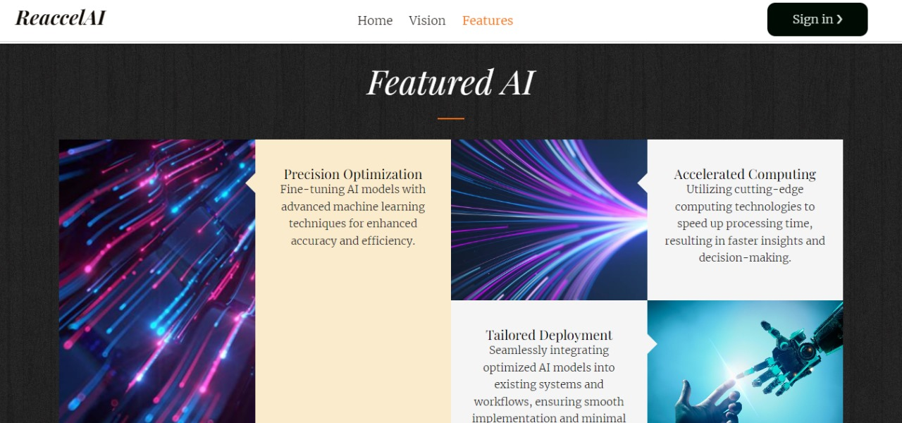
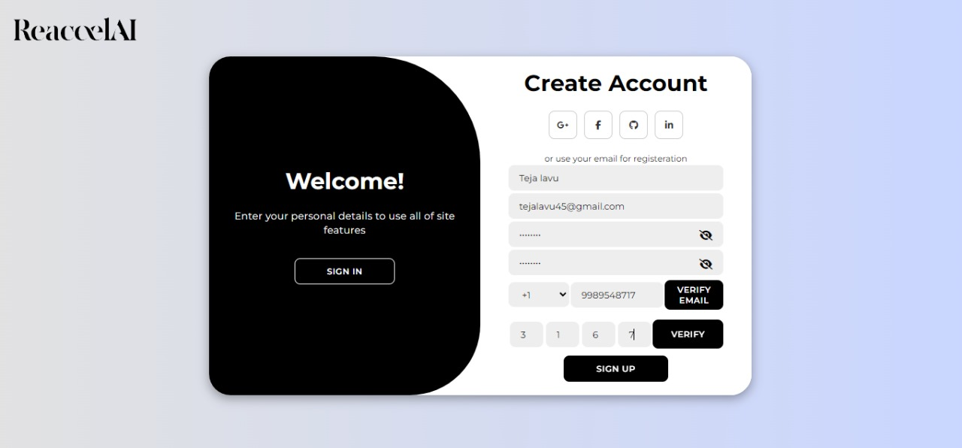
15.Sample Screenshot

Slide 43
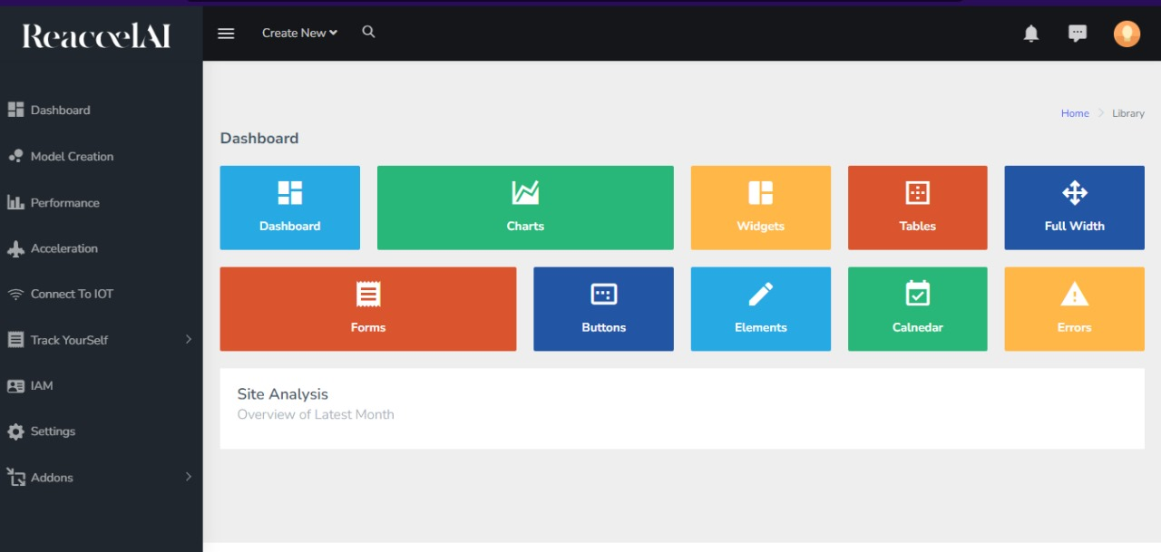

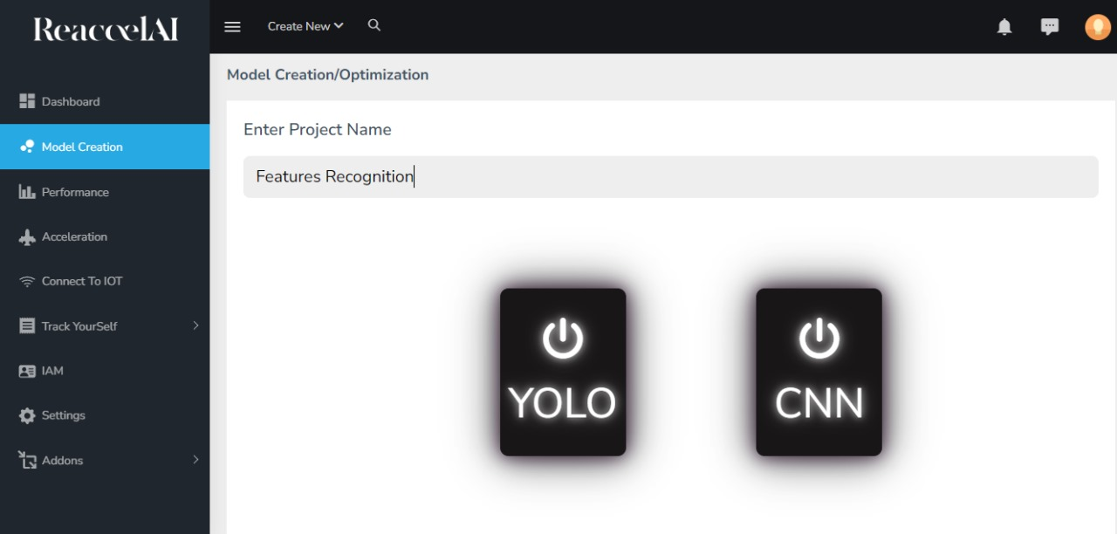
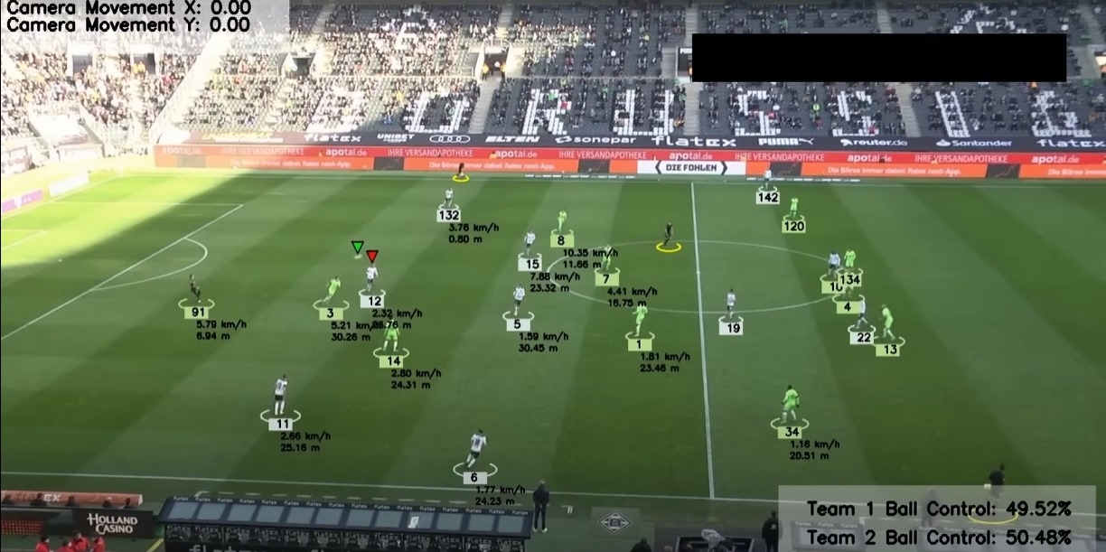
15.Sample Screenshot

Slide 44
Scope Of Future Enhancements

Slide 45
16. Scope Of Future Enhancements
The scope for improvements in ReaccelAI is vast, with opportunities to enhance model performance through advanced optimization techniques, expand model compatibility with emerging frameworks, optimize scalability for larger datasets, and implement real-time monitoring and automated deployment features.
Additionally, improvements in user interface, security measures, modular architecture, and community collaboration will further elevate the platform's capabilities and contribute to its continued evolution in the AI/ML landscape.
Expand model compatibility with emerging AI/ML frameworks. Optimize scalability for handling larger datasets. Implement real-time monitoring and automated deployment features.

Slide 46
Conclusion

Slide 47
17. Conclusion
ReaccelAI's development has been transformative, driven by the need for user-friendly, scalable, and efficient AI/ML solutions. By meticulously examining existing AI/ML systems, we identified key insights that informed our comprehensive platform.
ReaccelAI automates and streamlines the development process, utilizing cutting-edge tools like TensorFlow, PyTorch, Docker, and Kubernetes.
This project is not just about technology but about pushing the boundaries of AI and machine learning innovation.
ReaccelAI empowers developers to effortlessly build and enhance their models, symbolizing progress and limitless possibilities in the rapidly evolving tech landscape

Slide 48
THANK YOU

